Slide 1

Analysis of COVID Vaccination Rates

Slide 2
Overview
Reason Topic was selected -- address a public health issue
Datasources
Questions we hope to answer
Results
Notes:
Fun but overall fluff helpful as reminder for what jumping into. Maybe an overview of how the presentation will flow:

Slide 3
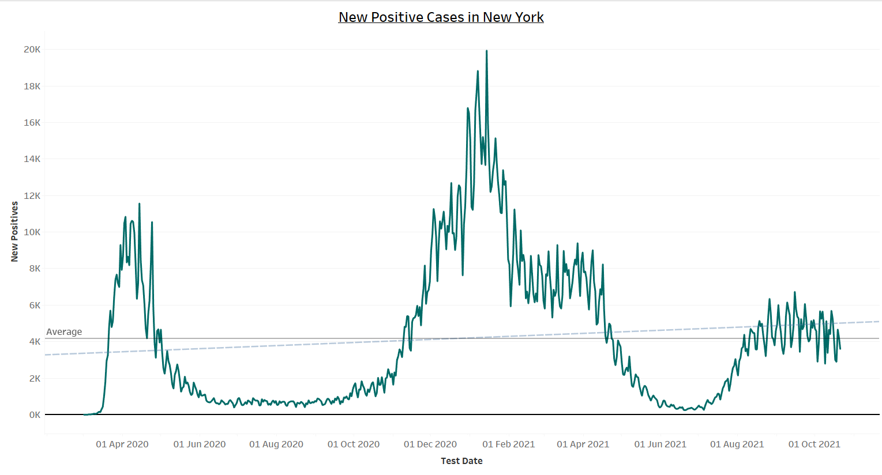
Notes:
Attention to rise in cases trend as we discuss boosters in our world and why we wanted to examine who gets vaccinated

Slide 4

What factors influence an individual to get the COVID-19 vaccine in New York State?
Notes:
The question(s) we hope to answer with the data. A story to be told: •
Analyst at Geo-Data-Lab have observed that pandemics did not begin with Covid 19 they in fact have always caused massive loss of lives globally
• They know that never before has there been a global deployment of vaccinations that may actually change the course of the future of pandemics in terms of loss of life
• However alarmingly there is not a 100% buy in by the population to vaccinate!
• The analysts have decided to focus their study on New York State one of the original epicenters of the Covid 19 virus
• They believe that a study on vaccination rates may shed light to the question
• What influences vaccination rates?
• They believe the answer to this question is important as it would not only help with the deployment of the current Covid 19 vaccination and booster shots
• They are hopeful that the information gleaned can be used as a catalyst in public acceptance of vaccinations and would make future deployments more successful!
• The CEO of GIT-Science USA – Dave Saranchak and his board of directors have gotten wind of the amazing research being conducted at Geo-Data-Lab
• They have showed interest in funding the research if the analyst can prove that their data driven insights can be used to understand the factors that drive vaccinations as well as use the observed results for future deployment of vaccinations
• Kristin Allocco, John Freeman, Helena Rabasco, Tara Keckeisen, Mikyle(Kyle) Yuvienco and Portia Wallace
• Will use their combined knowledge of ML, SQL, Tableau, GeoJson Maps to find and display insights from their research
• It will be great to get that funding and contribute to the future health of society at large!
]

Slide 5
Technology
Technology
Database
Machine LEarning
Visualization
Data Cleaning and Analysis
SciKitLearn & Tensorflow
Dashboard
Pandas, Python, & GoogleCollab.
ML libraries we'll be using to create a classifier
Heroku, HTML & Tableau
Database
Storage
PostgreSQL is the database used for data.
Notes:
Other potential visual of analysis process: Database → Machine Learning → Analysis → Visualization
*Discuss technology used at and what capacity

Slide 6
How we chain our analysis
Tech/Database
Feature Selection
Machine Learning
Visuals
Notes:
***Order: tech, database, feature selection [results of multiple regression for which factors most predictive], ML, Visuals displaying our data.
Discuss our exploration of the data

Slide 7




Gathering our Data
Notes:
Make note of the different sources where we starting pulling data from. Large amount of data collected on COVID-19. What do we use? How do we clean our data. We used Pandas, Python, and SQL to form our databases

Slide 8

API Data Source
Code used for API data pulls
Resource: https://covidactnow.org/data-api
Our original database pulled from multiple sources with different schemas. Covidactnow.org pulls and aggregates these sources for us together cleanly.
Notes:
COVIDActNow aggregated a lot of our data sources to an updated api

Slide 9

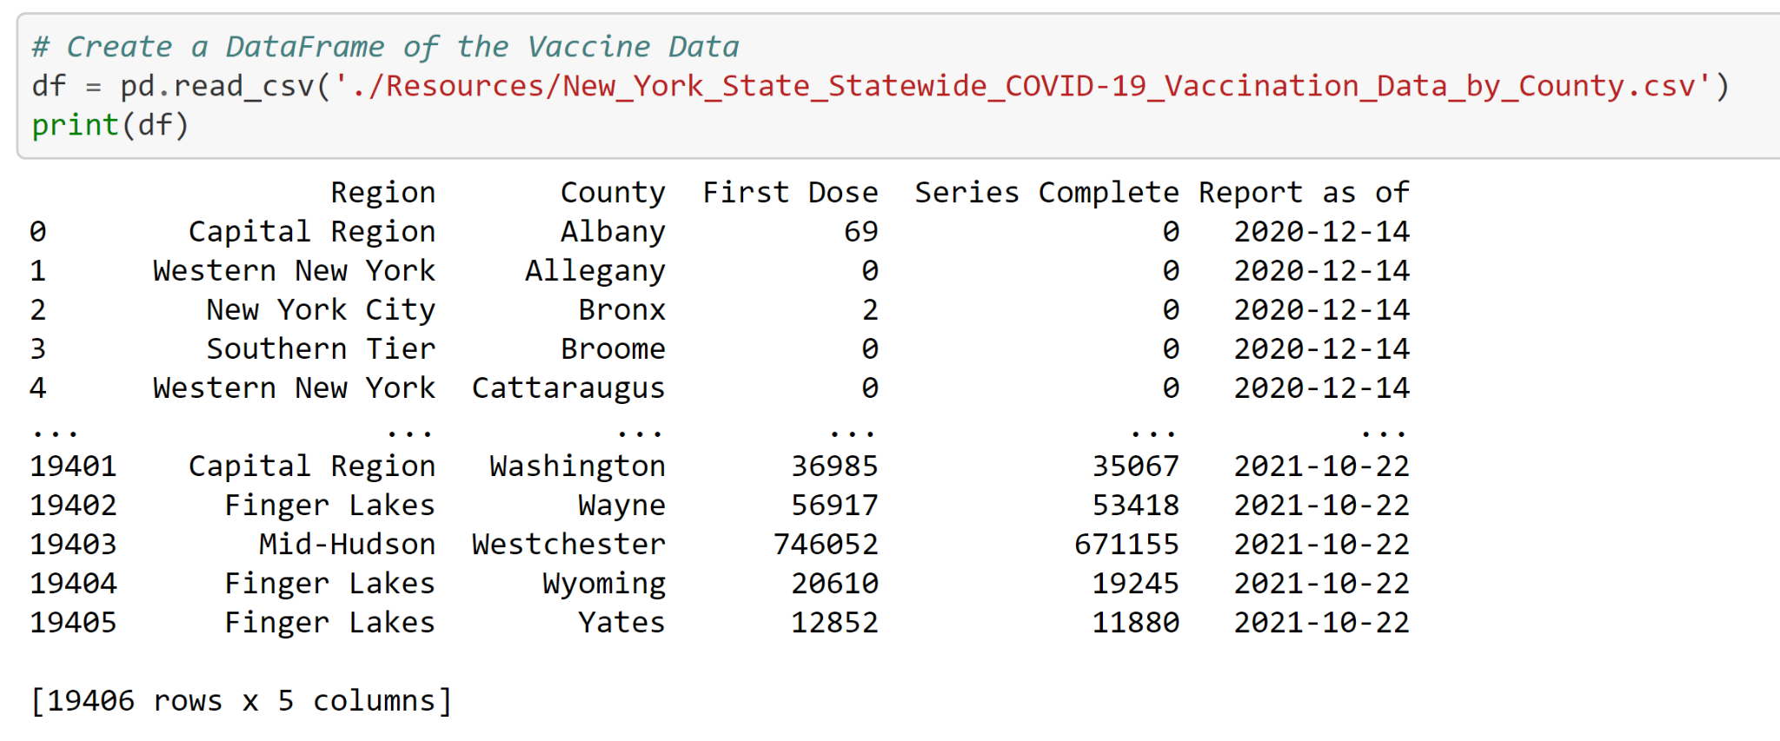
Database
Notes:
Section where speaker will discuss how we used Pandas and PostgreSQL to clean and create our database from our original datasets

Slide 10
Data Tables
Notes:
Have data tables to tell the story of how the data looks. Data Charts

Slide 11
19,406
rows
Notes:
Many vaccines. Such wow.

Slide 12
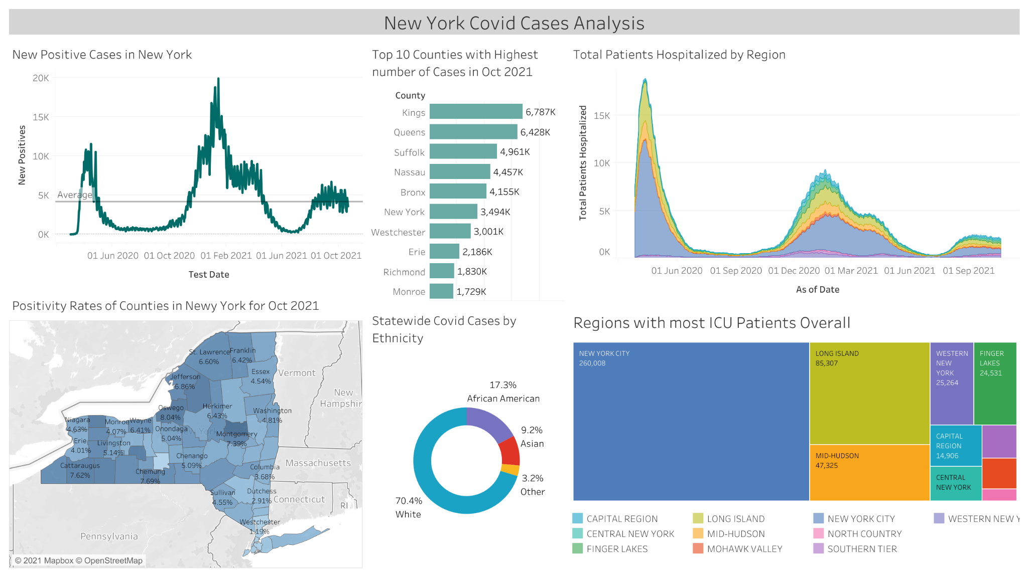
Now we have A LOT of data. How do we narrow down our focus?
Notes:
Visual and how we narrowed down our demo target. Begin exploration of analysis phase of project

Slide 13
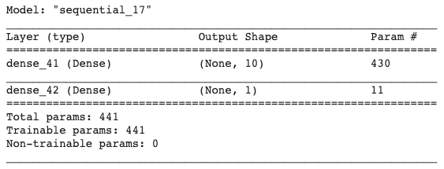
Machine Learning Slide
SciKitLearn/TensorFlow
We are using a neural network model to predict the COVID-19 vaccination rates of New York State residents. The model behaves like a regression model, where a dependant variable (vaccination rates) can be predicted from independent variables (demographic information).
Notes:
A slide discussing the machine learning model we used and the results

Slide 14

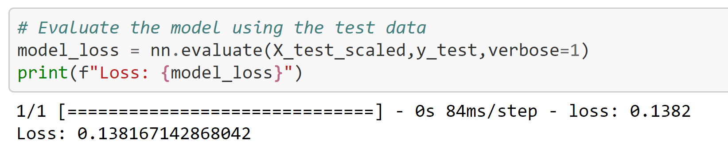
Machine Learning Slide
Results
The mean squared error (i.e., loss) was used to determine the model's efficacy. The model loss for the training and testing data were 0.1391 and 0.1382 respectively.
Notes:
A slide of the machine learning model we used

Slide 15
89,526,124
185,244 users
100%
That’s a lot
And a lot of users
Total success! 0% margin of error!
Notes:
Place holder of other big numbers of significant data to highlight after further analysis.

Slide 16
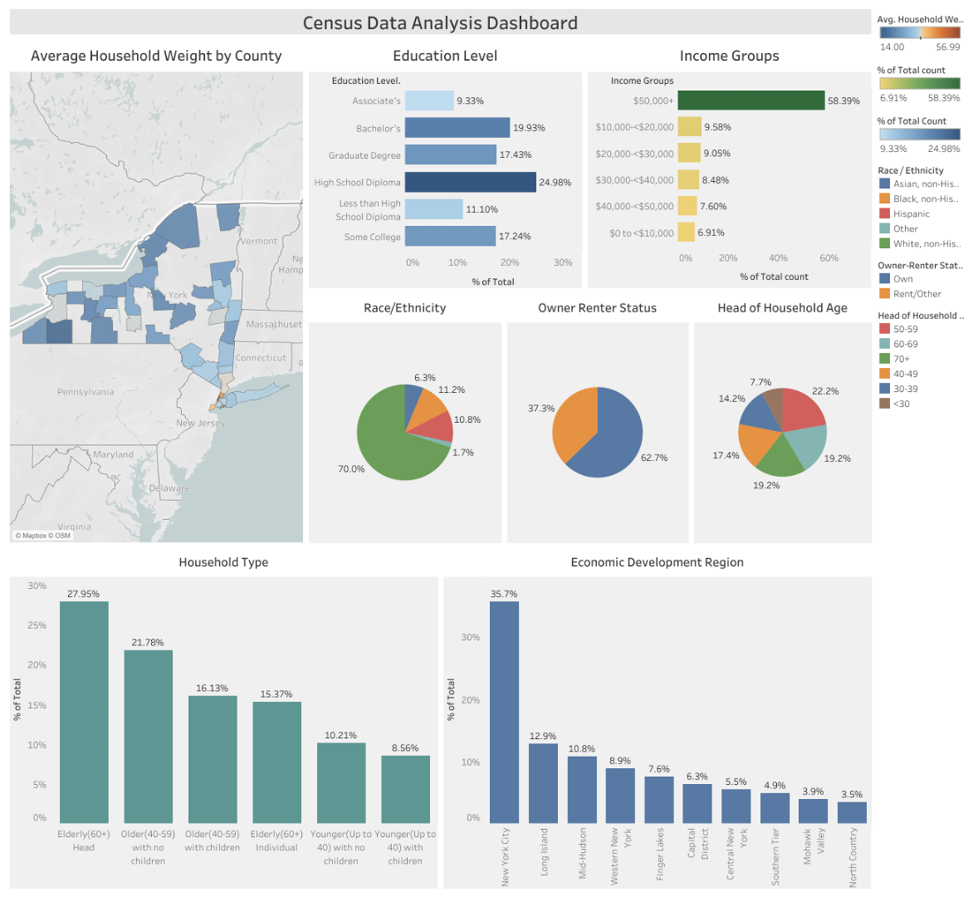

Notes:
First visuals should be of the database and the datasets we are using
NY Census Data Dashboard: https://public.tableau.com/app/profile/tara.keckeisen/viz/NYCensusDataAnalysisDashboard/Dashboard1

Slide 17
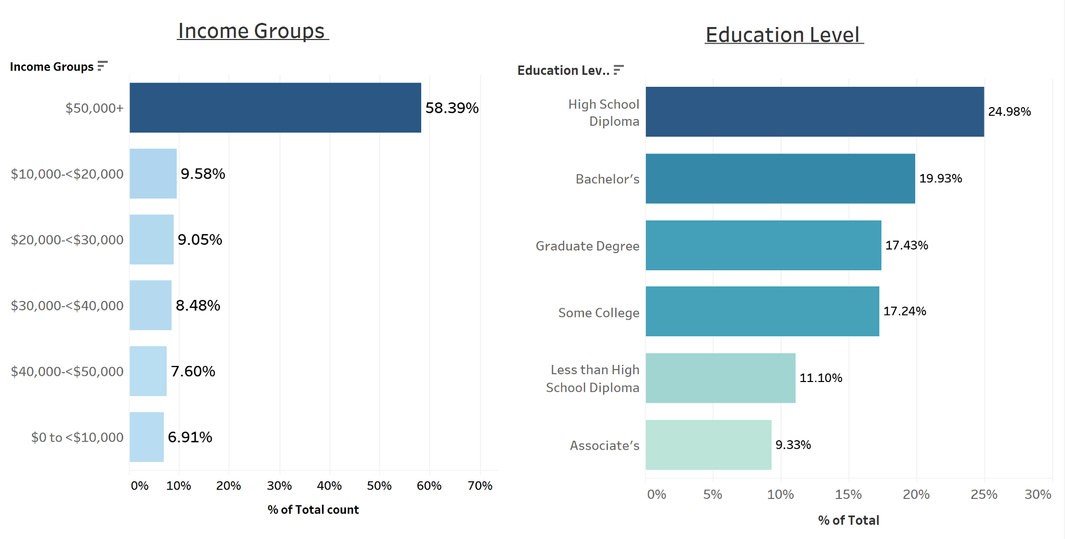
Notes:
NY Covid Cases Analysis: https://public.tableau.com/app/profile/tara.keckeisen/viz/CovidAnalysisDashboard_16361561521150/NewYorkCovidCasesAnalysis

Slide 18
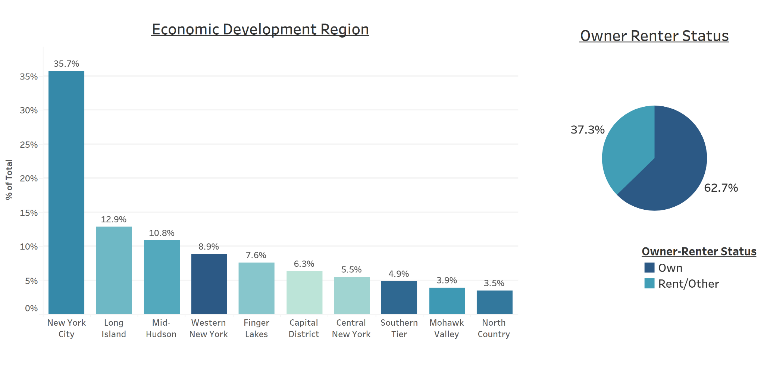
Notes:
Visual on map of vaccinations across NYS: https://public.tableau.com/app/profile/tara.keckeisen/viz/VaccinationInteractiveMapofNY/MetricMap?publish=yes

Slide 19
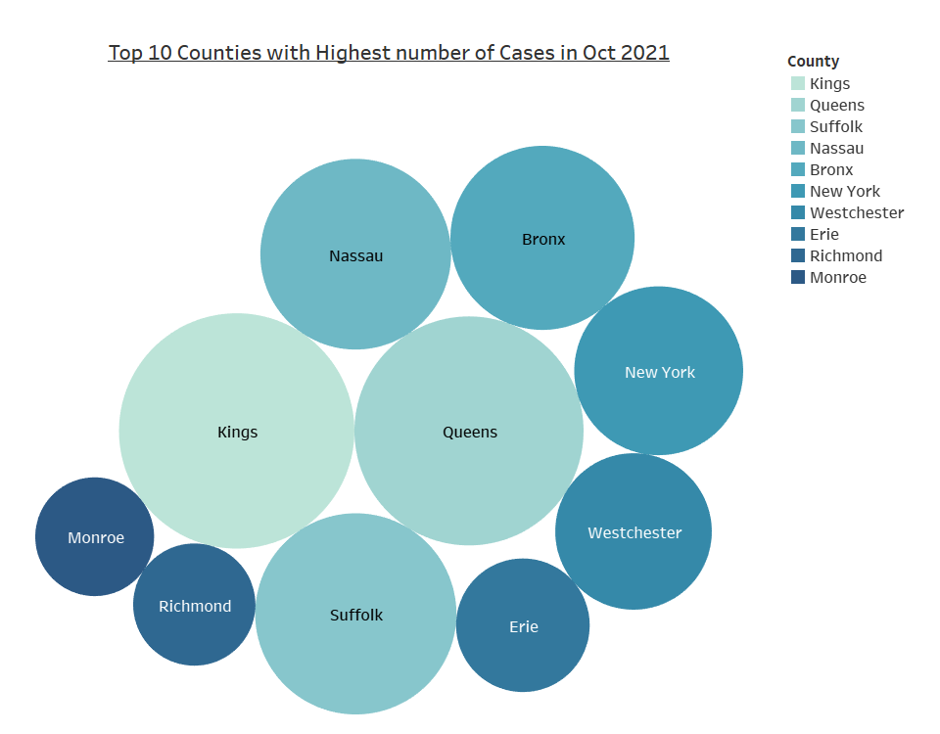
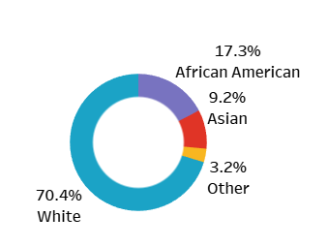
Notes:
Interactive graph link (Trend Chart by County & Doses): https://public.tableau.com/app/profile/tara.keckeisen/viz/TrendChartbyCountyandDoses/TrendChart?publish=yes
Interactive graph link (Doses Administered):https://public.tableau.com/app/profile/tara.keckeisen/viz/DosesAdministered_16361597995400/DosesAdministeredvs_FullyVaccinatedPopulation?publish=yes

Slide 20
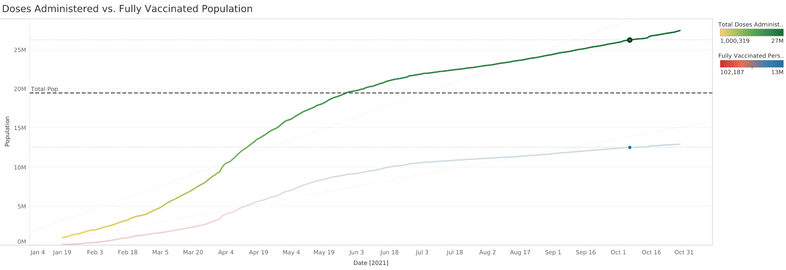
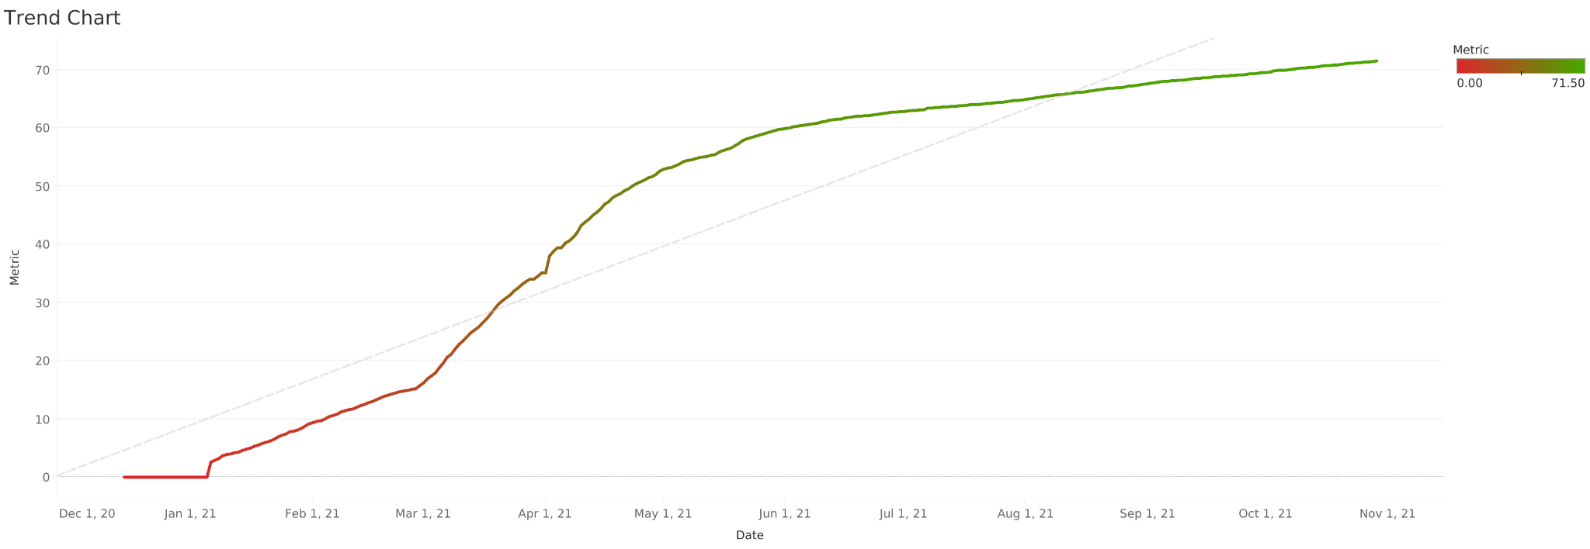
Notes:
Interactive graph link (Trend Chart by County & Doses): https://public.tableau.com/app/profile/tara.keckeisen/viz/TrendChartbyCountyandDoses/TrendChart?publish=yes
Interactive graph link (Doses Administered):https://public.tableau.com/app/profile/tara.keckeisen/viz/DosesAdministered_16361597995400/DosesAdministeredvs_FullyVaccinatedPopulation?publish=yes

Slide 21
Maps - Vaccinations
New York State
Notes:
Map template

Slide 22
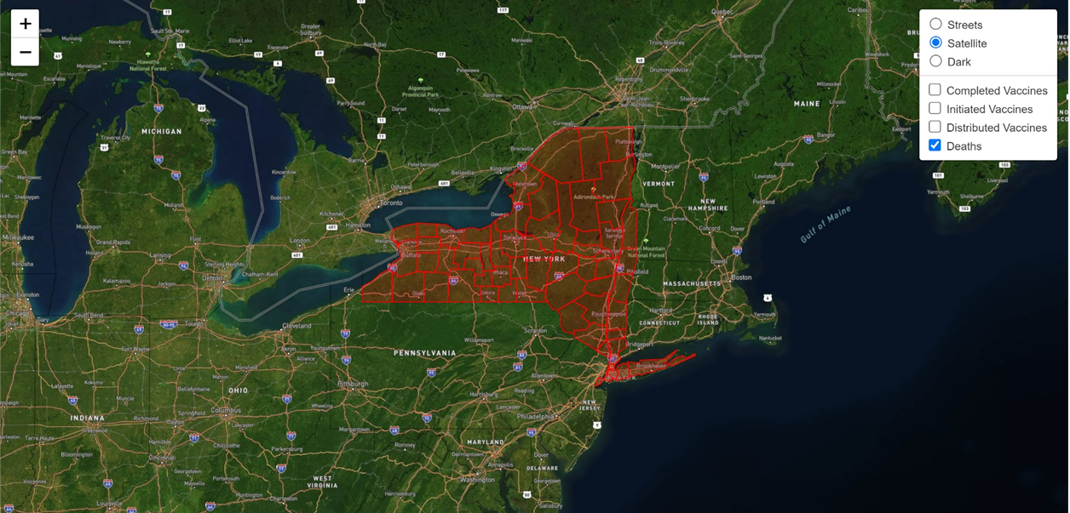
Maps - Vaccinations
Notes:
GeoJSON map screenshot. Will lead into the finished Dashboard tour section of presentation.

Slide 23
Results
Yellow
Is the color of gold, butter and ripe lemons. In the spectrum of visible light, yellow is found between green and orange.
Blue
Is the colour of the clear sky and the deep sea. It is located between violet and green on the optical spectrum.
Red
Is the color of blood, and because of this it has historically been associated with sacrifice, danger and courage.
Notes:
Results of our findings. Next few slides discussing the results, and how we can improve on our analysis with more time.

Slide 24
SWOT Analysis
STRENGTHS
Blue is the colour of the clear sky and the deep sea
WEAKNESSES
Yellow is the color of gold, butter and ripe lemons
S
W
Black is the color of ebony and of outer space
OPPORTUNITIES
White is the color of milk and fresh snow
THREATS
O
T
Notes:
SWOT is great for post-mortem analysis of our data and how we can improve. STAY SAFE FRIENDS. DISCUSS THE FACTORS WE ANALYZE AND IT IS A UNIVERSAL ISSUE. ACCESS TO CARE AND INCOME DATA. WE DID NOT ACCOUNT COUNTY MANDATES AND HOW THEY FACTOR ACESSIBILITY.

Slide 25
Credits
Special thanks to all the people who worked on this analysis and the sources we used:
https://covidtracking.com/
https://health.data.ny.gov/browse?tags=covid-19
https://www1.nyc.gov/site/planning/planning-level/nyc-population/2020-census.page##2020-census-results

Slide 26
Team Presentation
Talk Data To Me
Kyle Yuvienco
Team Leader
Kristin Allocco Team Member
Portia Wallace
Team Member
John Freeman
Team Member
Helena Rabasco
Team Member
Tara Keckeisen Team Member
Notes:
Make this us.

Slide 27
THANKS!

